Slide 1

OS161-Virtual Memory with Demand Paging
Davide Milone
William Tessitore
Alessandro Campisi

Slide 2
Contents
Flow chart Algorithms
Memory management
Initialization
Allocation
De-allocation
Swap management
VM fault
Data structures
Frame Allocator
Allocation Size
Page Table
Entry Valid
Free Frame List
Swap File
Test

Slide 3

Flow Chart Algorithms

Slide 4
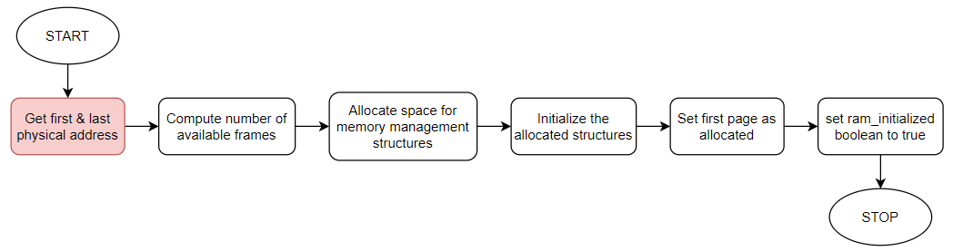
Memory management - Initialization

Slide 5
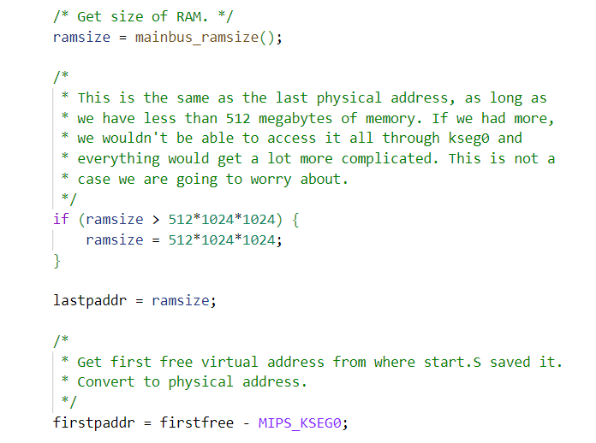
Memory management - Initialization

Slide 6
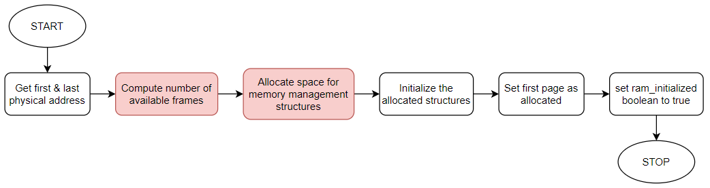
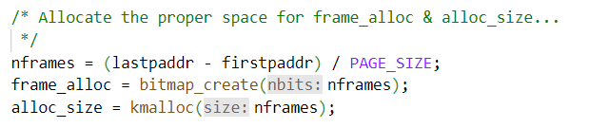
Memory management - Initialization

Slide 7
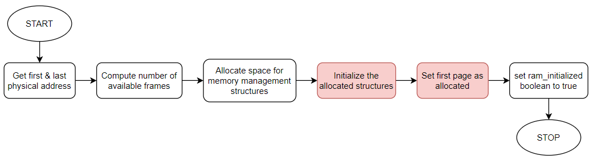
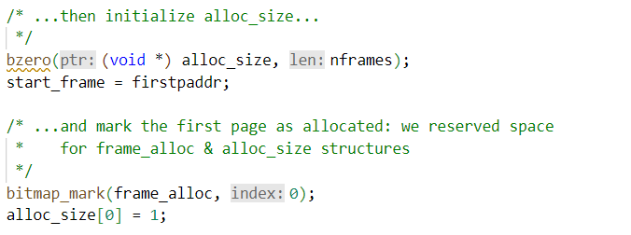
Memory management - Initialization

Slide 8
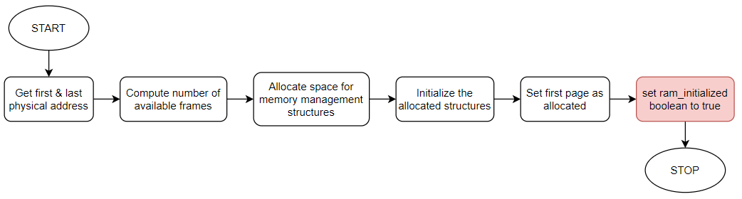
Memory management - Initialization

Slide 9
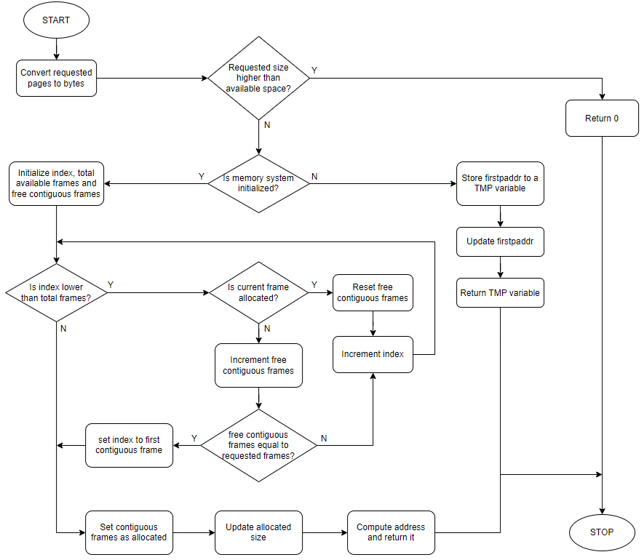
Memory management - Allocation

Slide 10
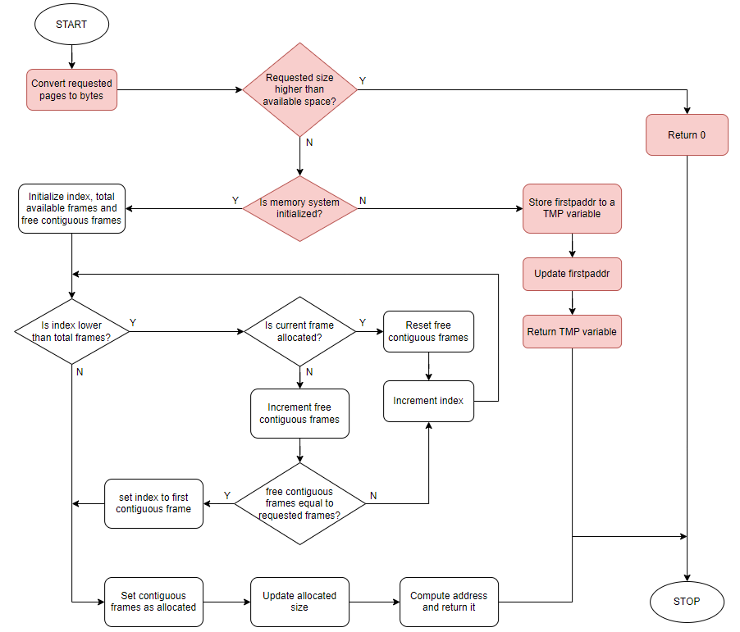
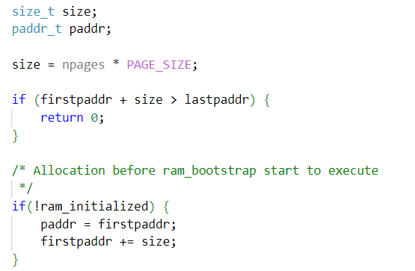
Memory management - Allocation

Slide 11
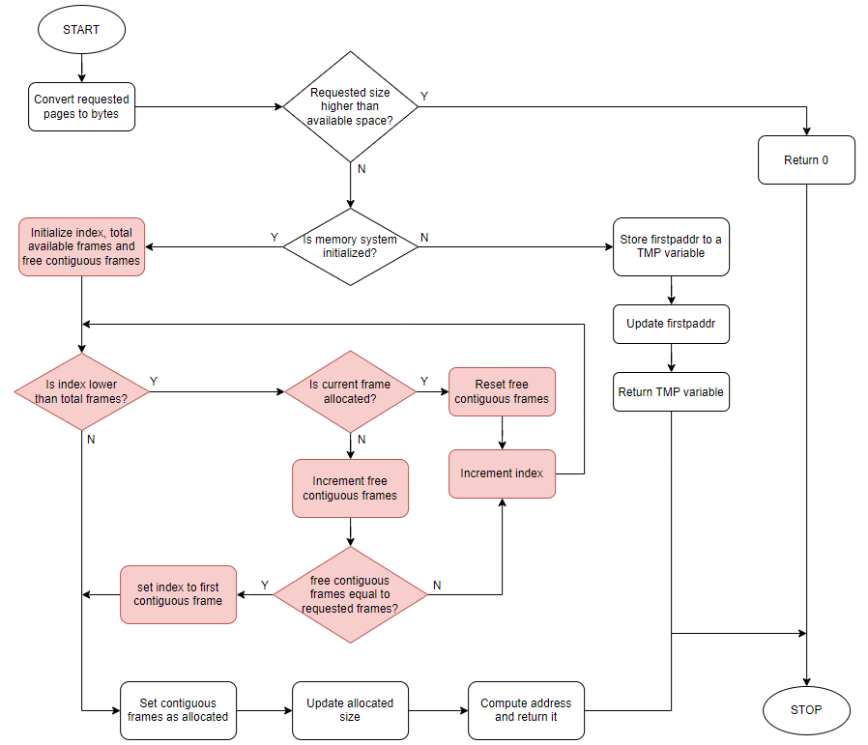
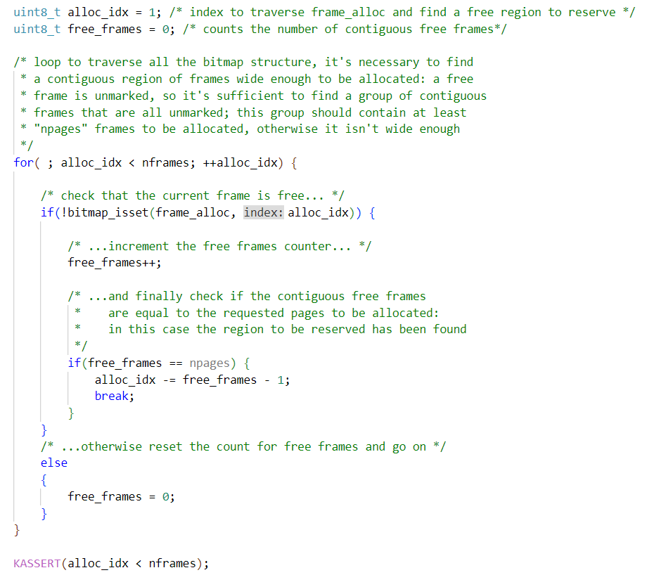
Memory management - Allocation

Slide 12
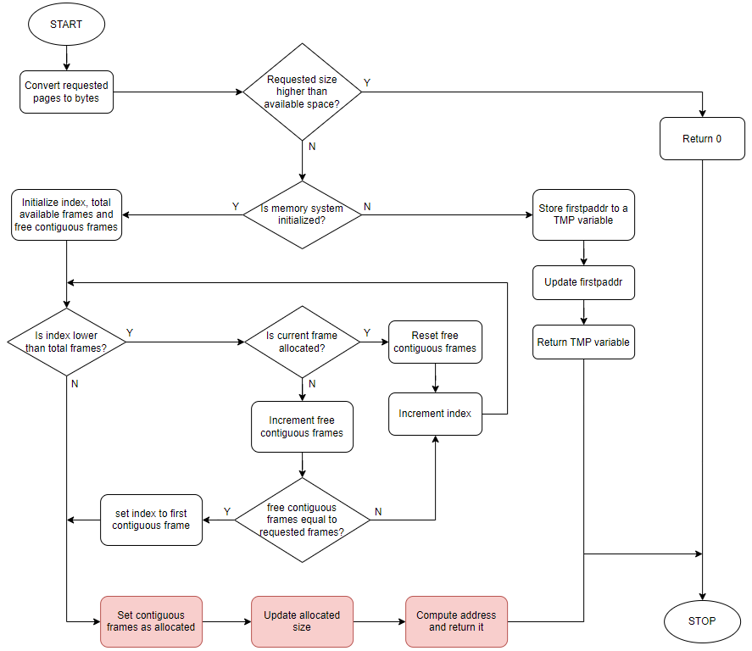
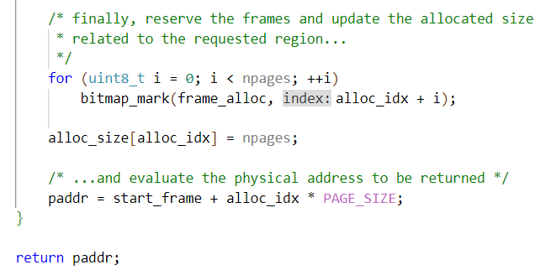
Memory management - Allocation

Slide 13
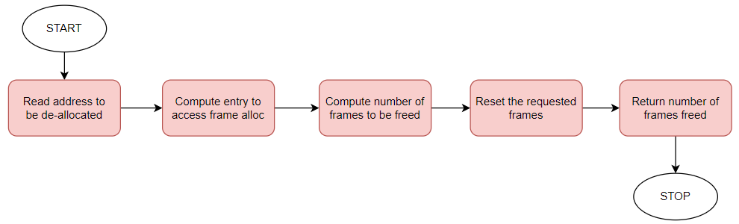
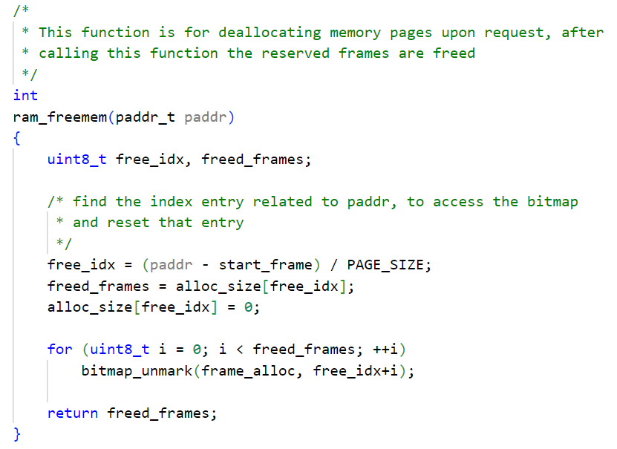
Memory management – De-Allocation

Slide 14
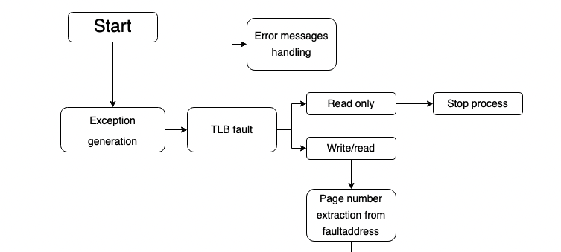
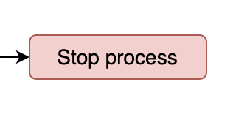
VM Fault 1/13

Slide 15
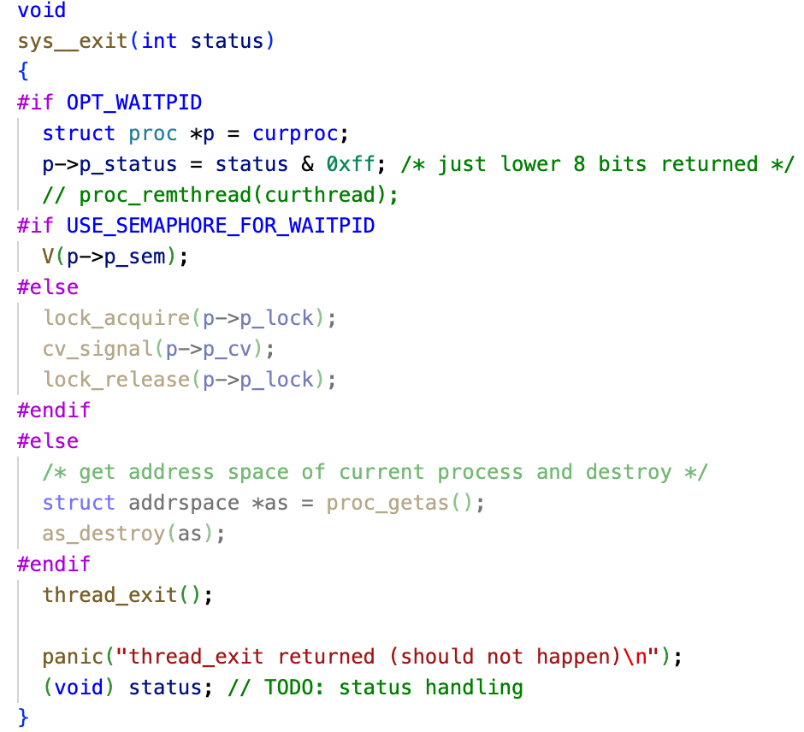
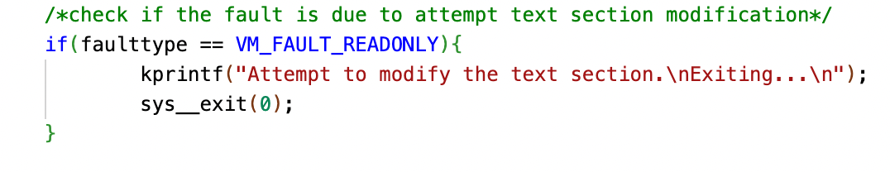
Stop process
Sys_exit(0)

Slide 16
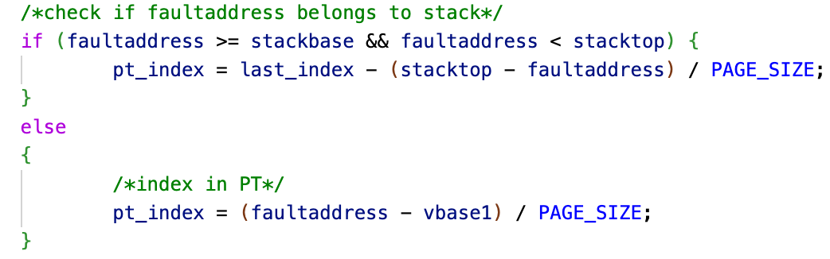
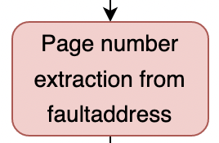
VM Fault 2/13

Slide 17
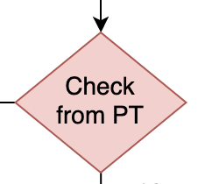
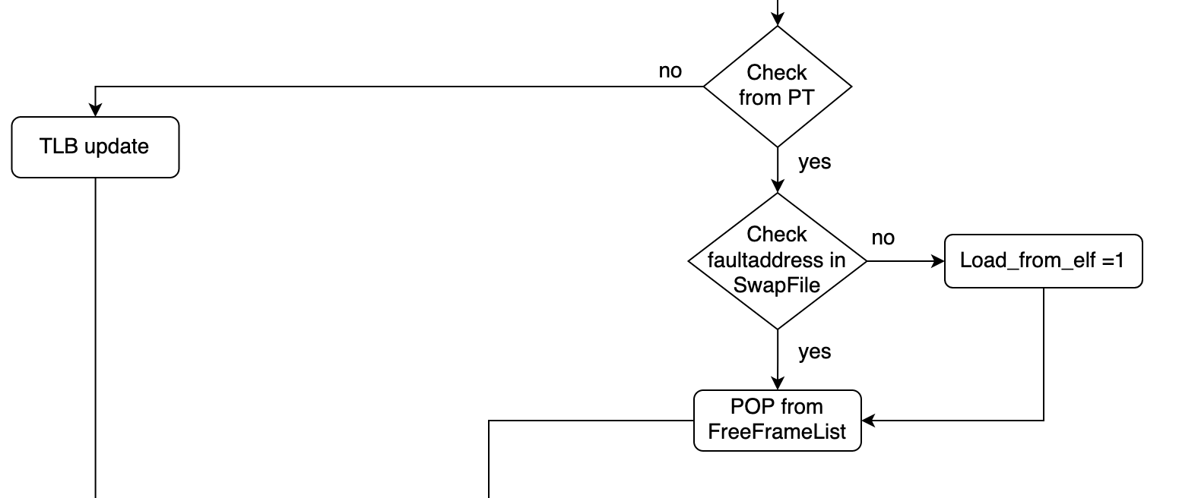
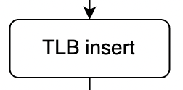
VM Fault 3/13

Slide 18

Check PT
Page entry validity should be checked to decide how to handle the fault
Two possibilities:
TLB fault
An actual page fault
Valid/Invalid entry depends on the entry content:
Different from NULL = frame address (valid entry)
Equal to NULL = invalid entry

Slide 19
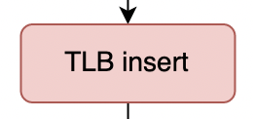
VM Fault 4/13

Slide 20
TLB insert
TLB_insert(paddr_t paddr1, paddr_t paddr2, int flag, vaddr_t faultaddress)
Look for an invalid entry
Calls RR Algorithm if TLB is full
Replace invalid entry with the new one
Returns 0 if it found at least one invalid entry
Returns 1 if RR Algorithm is used

Slide 21
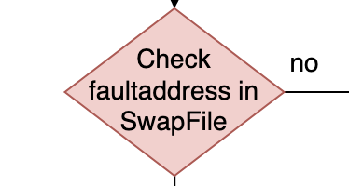
VM Fault 5/13

Slide 22
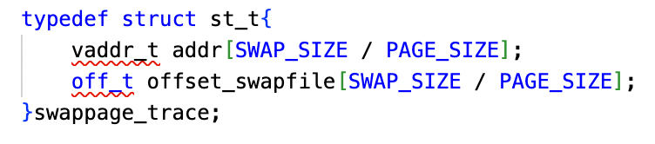
Swap File
Swappage_trace()
Vector of virtual addresses
Vector of offsets swapfile
Search_swapped_frame(vaddr_t vaddr)
Search vaddr address in Swappage_trace()
Returns offset in Swap File if the frame is present
Returns -1 if is not present

Slide 23
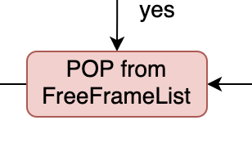
VM Fault 6/13

Slide 24
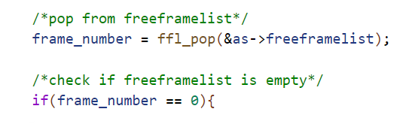
POP FreeFrameList
New frame address should be popped in case of a page fault
What if the free frame list is empty?
Need to check this case and decide how to go on
Return value from POP function is used:
Different from NULL = frame address available
Equal to NULL = free frame list empty (page replacement)

Slide 25
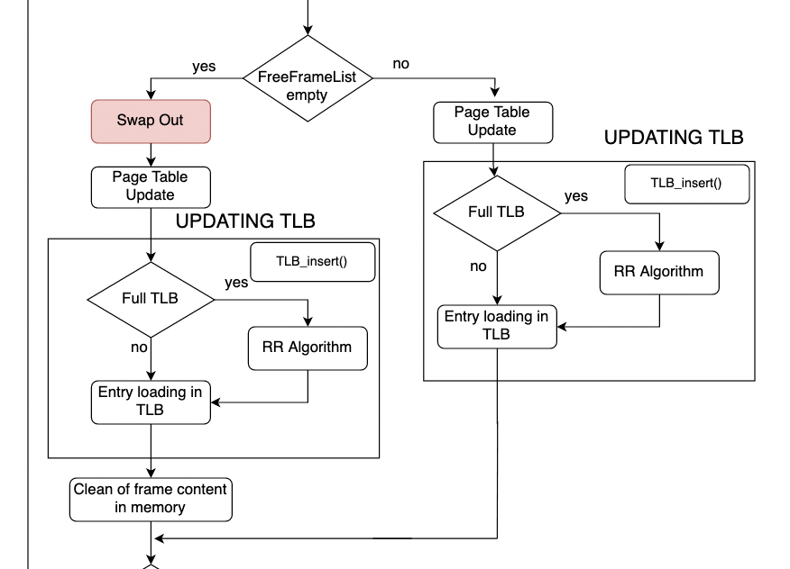
VM Fault 7/13

Slide 26
Swap OUT 1/3
BEFORE SWAP-OUT:
Retrieve the old frame from Page Table
Check if the frame is already into SWAP FILE (replace it)
Allocate a new frame into SWAP FILE if nedeed (Swap_alloc())
SPECIFIC CASE:
Old Frame from Page Table doesn’t match with TLB entry
Save the first TLB entry in temporary variable
Replace it with the corresponding new entry
Swapping
Restore the initial TLB entry

Slide 27
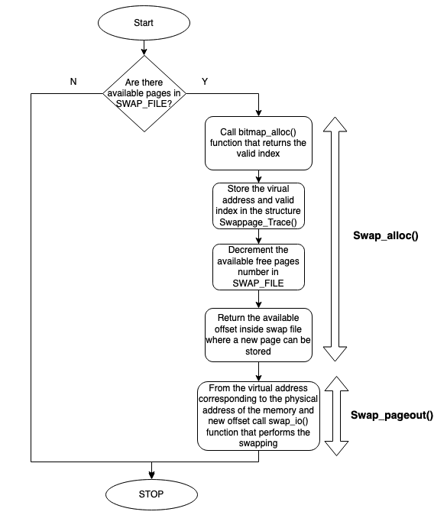
Swap OUT 2/3

Slide 28
Swap OUT 3/3
Swap_alloc(vaddr_t vaddr)
Search 0 in bit map structure and sets it to 1
Offset computation (index*PAGE SIZE)
Updates swappage_trace() (offset and physical addrres)
Returns allocation offset
Swap_pageout(vaddr_t vaddr, off_t swapaddr)
Calls swap_io(vaddr_t vaddr, off_t swapaddr, int rw) function
Allocates pages in SwapFile

Slide 29
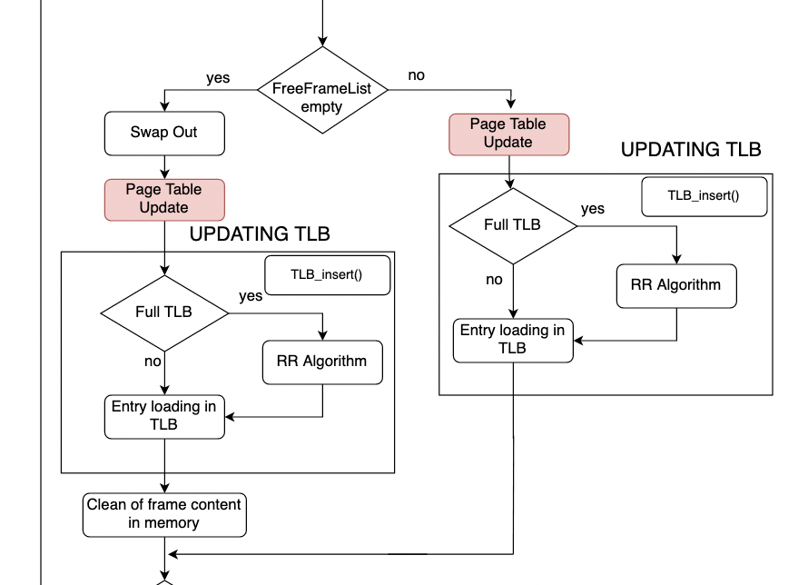
VM Fault 8/13

Slide 30
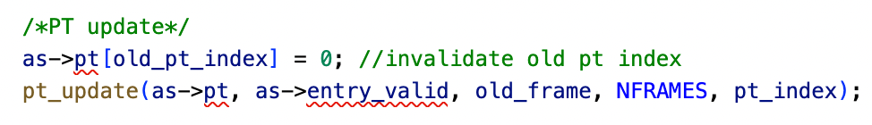
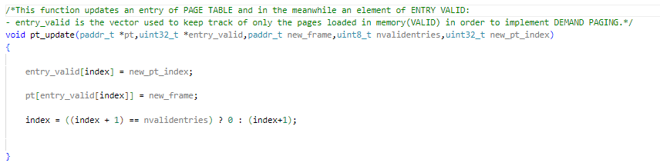
Page Table update 1/2
Page replacement:
Invalidate old index of Page
Table
- Update entry_valid
Update the Page Table
Update index

Slide 31
Page Table update 2/2
Two elements are important in this function:
Index: this variable contains the victim index for the replacement;
Entry_valid: this vector is essential to take into account only those entries of the page table related to the only frames present in memory. This allows to speed up access to page table because the search for the entry reduces to an access to entry_valid index before and, through entry_valid, to the page table index. So no need for a loop to check the valid bit of every entry of page table.
-At the end of the function index is either incremented(FIFO policy) or cleared to zero if it reaches nvalidentries value, which is the number of frames allocated in memory.

Slide 32
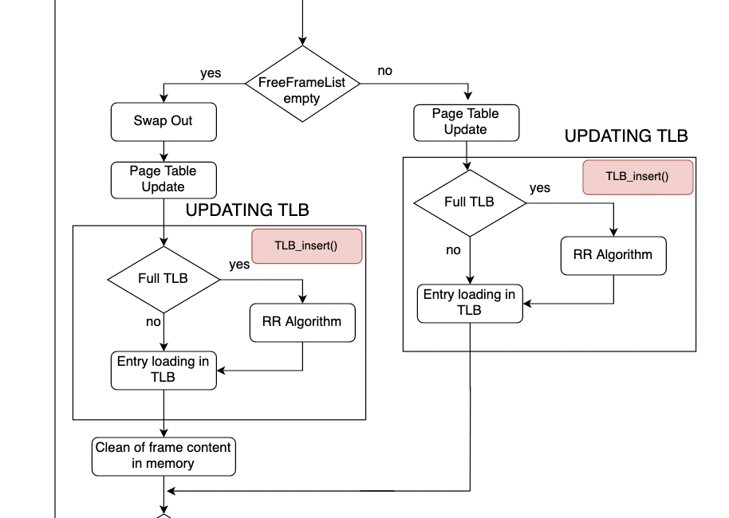
VM Fault 9/13

Slide 33
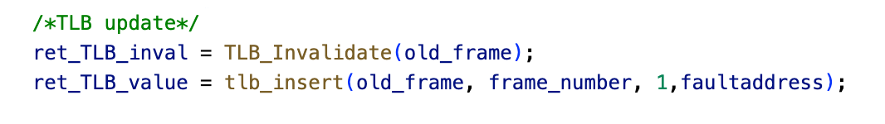
Updating TLB 1/5

Slide 34
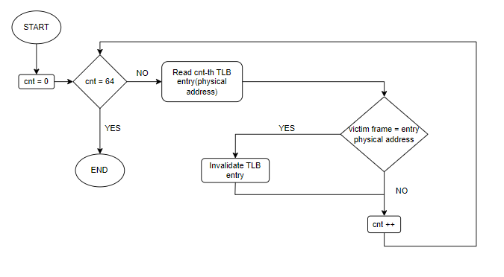
Updating TLB 2/5
TLB Invalidate

Slide 35
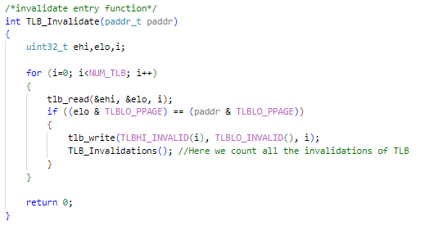
Updating TLB 3/5

Slide 36
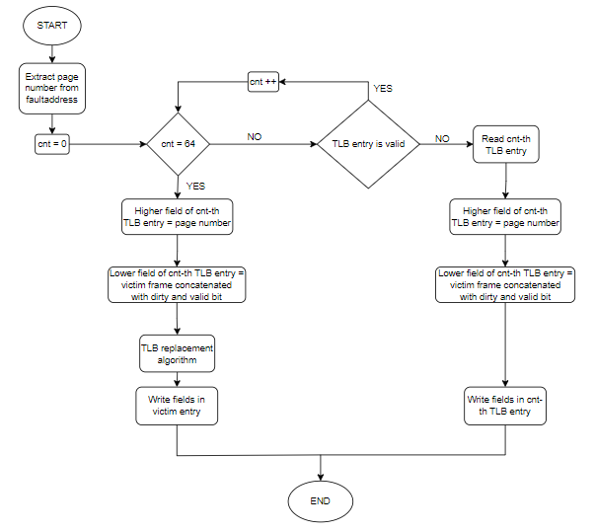
Updating TLB 4/5
TLB Insert

Slide 37
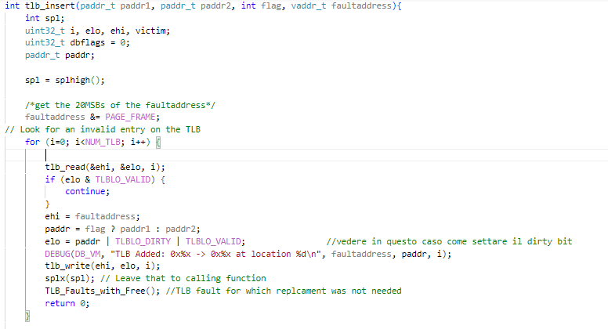
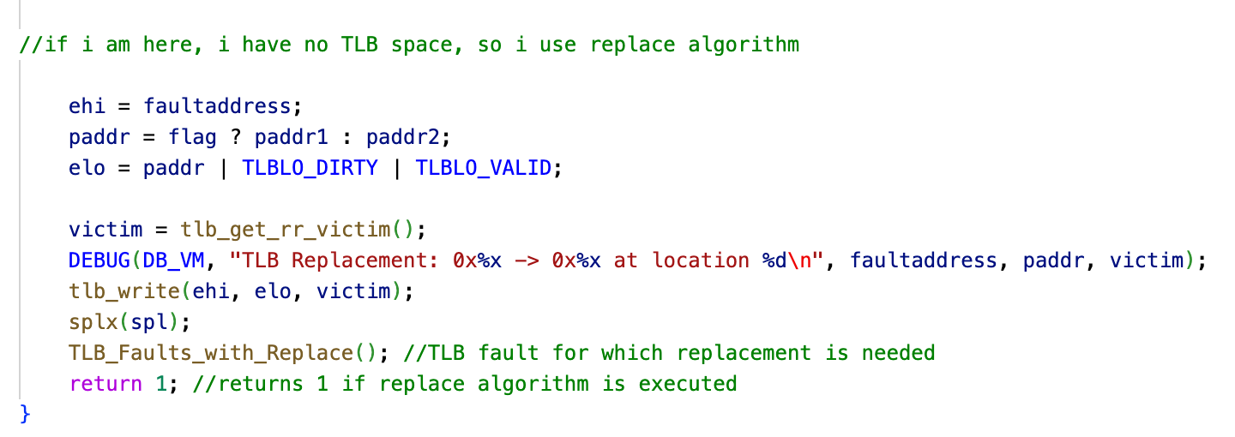
Updating TLB 5/5

Slide 38
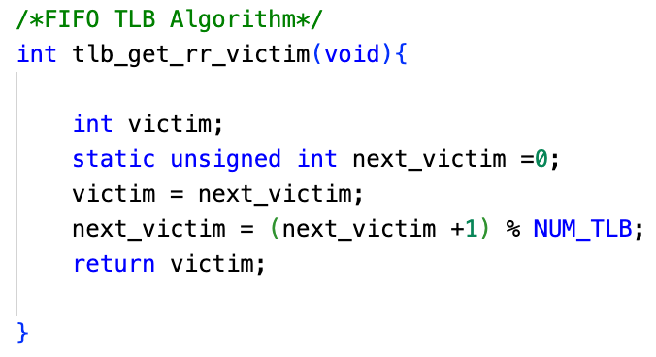
RR Algorithm
First IN First OUT Algorithm

Slide 39
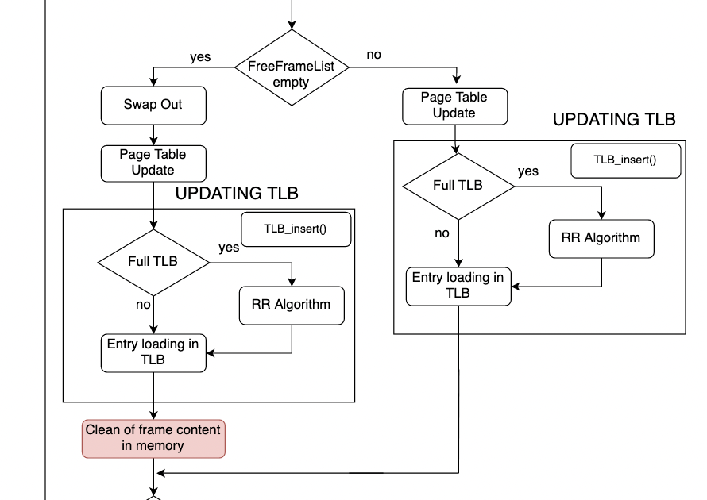
VM Fault 10/13

Slide 40

Clean Memory frame

Slide 41
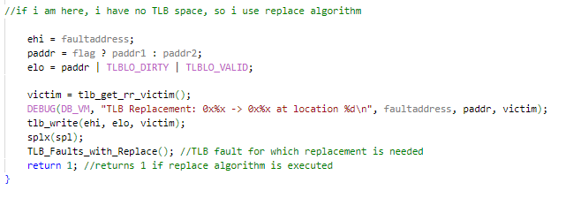
Entry Loading in TLB
DA RIVEDERE (PUO ESSERE CANCELLATA)

Slide 42
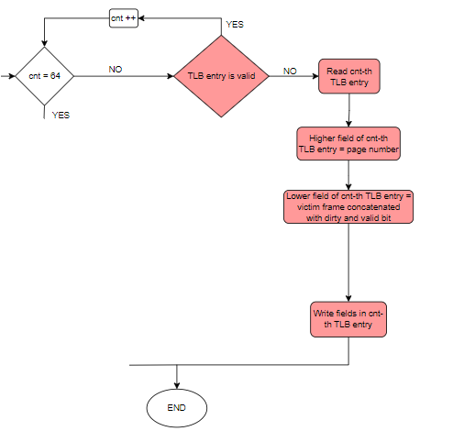
TLB update
TLB Insert(No Replacement)
DA RIVEDERE

Slide 43
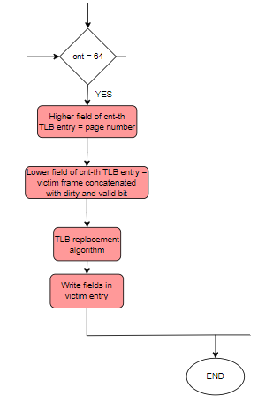
TLB update
TLB Insert(Replacement)
DA RIVEDERE
DA RIVEDERE

Slide 44
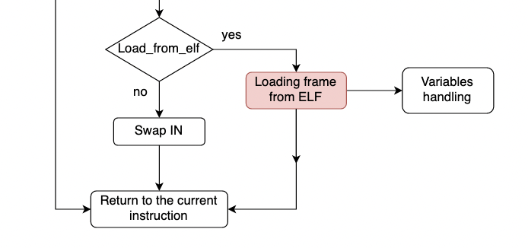
VM Fault 11/13

Slide 45
Load frame from ELF 1/8
Load_elf(struct vnode *v, vaddr_t *entrypoint)
Reads informations from ELF FILE
Calls ad_define_region() function
Returns entrypoint
Load_page_fromELF(int offset, vaddr_t vaddr, size_t memsize, size_t filesize, int is_executable)
Chech if filesize is grather than memsize
Set filesize value
Writing memory

Slide 46
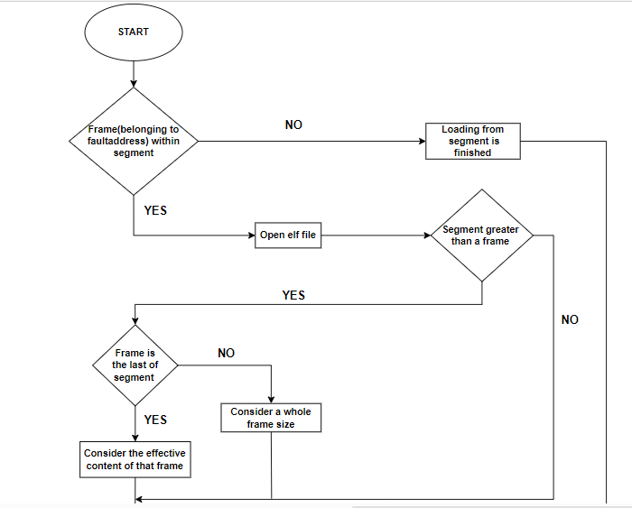
Load frame from ELF 2/8

Slide 47
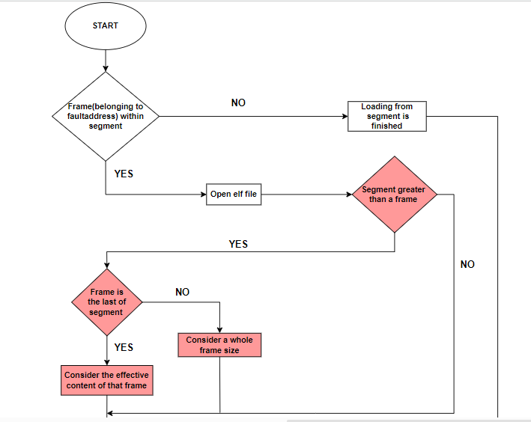
Load frame from ELF 3/8

Slide 48

Load frame from ELF 4/8
-It is important to check whether the frame is the last of the segment or not:
Usually what happens is that the segment is not an exact multiple of a frame size (4096 BYTES).
It means that implementing DEMAND PAGING, so selecting only a page each time, the last page of a segment will have surely a dimension lower than 4096 BYTES and it must be guaranteed to upload exactly that content in order to not let the system crash.

Slide 49

Load frame from ELF 5/8

Slide 50

Load frame from ELF 6/8

Slide 51

Load frame from ELF 7/8

Slide 52

Load frame from ELF 8/8

Slide 53

VM Fault 12/13

Slide 54

Swap IN 1/2

Slide 55


Swap IN 2/2
Search_swapped_frame(vaddr_t vaddr)
Swappage_IN(vaddr_t vaddr, off_t swapaddr)

Slide 56

VM Fault 13/13

Slide 57
Data structures

Slide 58
Data Structures – Frame Allocator
FRAME ALLOCATOR
Tracks all the frames allocated
Its length equals the total number of available frames
FRAME ALLOCATOR - IMPLEMENTATION
Realized as a pointer to a «bitmap» data structure
Frame allocator length is dynamic
Each entry is a single bit representing a single frame
If set, the corresponding frame is reserved (allocated)
If unset, the corresponding frame is available (free)
Methods available to handle the page table:
void ram_bootstrap(void)
initializes the memory allocation system, by creating the frame allocator
paddr_t ram_stealmem(unsigned long npages)
reserves a countiguous block of pages equal to «npages»
the corresponding bits inside frame allocator are set
int ram_freemem(paddr_t paddr)
Releases the block of pages related to «paddr»
the corresponding bits inside frame allocator are reset

Slide 59
Data Structures – Allocation Size
ALLOCATION SIZE
Tracks the block of contiguous frames reserved for every structure allocated
ALLOCATION SIZE - IMPLEMENTATION
Realized as a pointer to a «uint8_t» variable
Every entry potentially stores the number of contiguous frames allocated
Not every entry stores a meaningful value
e.g. if we need 4 contiguous frames starting from index «8», then we assign «4» to element «8» of alloc_size, while the following three elements of alloc_size are unused
Methods available to handle the page table:
same as for frame_allocator

Slide 60
Data Structures – Page Table
PAGE TABLE
Performs page-to-frame translation
Access through the page number, the content accessed is the frame number
Used in case of TLB fault
PAGE TABLE - IMPLEMENTATION
Realized as a pointer to a «paddr_t» variable
Page Table length is dynamic
Each entry is a variable of type paddr_t
Access performed through the page number
Methods available to handle the page table:
paddr_t * pt_create(size_t nentries)
creates the page table by allocating «nentries» entries
void pt_destroy(paddr_t * pt_dest)
destroys the page table «pt_dest» by freeing resources allocated

Slide 61
Data Structures – Page Table
PAGE TABLE - IMPLEMENTATION
Methods available to handle the page table:
paddr_t get_victim_frame(paddr_t *pt,uint8_t *entry_valid)
returns the victim frame of page_table «pt», located at the entry «entry_valid»
uint32_t get_victim_pt_index(uint32_t *entry_valid)
returns the page_table index specified by «entry_valid»
vaddr_t get_page_number(vaddr_t virtualaddr,uint32_t *entry_valid)
returns the page number, «virtualaddr» is the base virtual address, «entry_valid» the offset
void pt_update(paddr_t *pt,uint32_t *entry_valid,paddr_t new_frame,uint8_t nvalidentries,uint32_t new_pt_index)
updates the page table «pt» at the entry «new_pt_index» by storing «new_frame»
«entry_valid» is updated as well with «new_pt_index»

Slide 62
Data Structures – Entry Valid
ENTRY VALID
Contains the page table index of all the valid entries
Used to speed up the search for a valid entry through the page table
ENTRY VALID – IMPLEMENTATION
Realized as a pointer to a «uint8_t» variable
Each variable describes a page table index with a valid entry
Its length matches the number of frames allocated for user program execution
Methods available to handle the entry valid structure:
uint32_t get_victim_pt_index(uint32_t *entry_valid)
void pt_update(paddr_t *pt,uint32_t *entry_valid,paddr_t new_frame,uint8_t nvalidentries,uint32_t new_pt_index)
Both methods are already described in the previous slide

Slide 63
Data Structures – Free Frame List
FREE FRAME LIST
Handles the available frame addresses provided to the process
Works as a stack
Filled at the beginning, before the process starts execution
Gradually emptied, until no more frame are available (page replacement)
FREE FRAME LIST- IMPLEMENTATION
Realized as a pointer to a «ffl» structure
Each «ffl» structure is composed by:
A «paddr_t» variable representing the available frame
A pointer to the previous «ffl» structure
A pointer to the next «ffl» structure

Slide 64
Data Structures – Free Frame List
FREE FRAME LIST- IMPLEMENTATION
Methods available to handle the free frame list:
struct ffl * ffl_create(const uint8_t nframes)
Creates the free frame list and performs all the links between adjacent ffl structures, by assigning the proper address to pointers of next/previous «ffl» structure
void ffl_init(struct ffl ** ffl_init, uint8_t nframes)
Initializes the «ffl» structure by filling it with all the frames provided to the process
void ffl_push(struct ffl ** ffl_push, const paddr_t fr_push)
The pointer is moved to the next «ffl» structure, then it pushes to the «ffl» top an available frame
paddr_t ffl_pop(struct ffl ** ffl_pop)
Pops from the «ffl» top a frame to be used, then the pointer is moved to the previous «ffl» structure
void ffl_destroy(struct ffl * ffl_dest)
Destroys the free frame list

Slide 65
THANKS!

